Slide 1
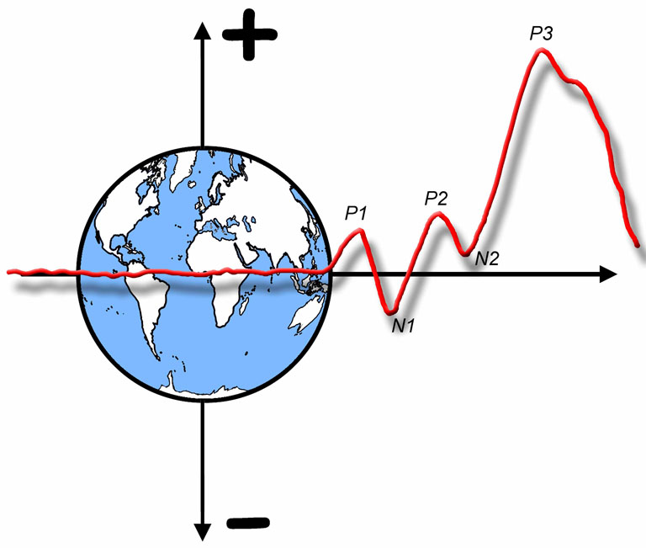

The ERP Boot Camp
Statistical Analysis of ERP Data

Slide 2
Lecture Overview
Review of basic stats terminology
Truth vs. statistical significance
The world’s best statistic
The standard approach to ERP analysis
The million dollar statistical approach
How to go from p = .258 to p = .0017 (ethically)
The problem of multiple comparisons in ERP research
How flexibility in choosing time windows and electrode sites leads to bogus findings
Appropriate methods for choosing time windows and electrodes sites
Notes:
© S. J. Luck. All Rights Reserved. May be used for nonprofit educational purposes if this copyright notice is included. Permission must be obtained from the copyright holder(s) for any other use.

Slide 3
Some Terminology
Null hypothesis vs. alternative hypothesis
Type I error
False positive: Rejecting the null hypothesis when it is true
“Bogus effect”
Type II error
False negative: Accepting the null hypothesis when it is false
Alpha
Nominal probability that a Type I error rate will occur
Usually .05
Statistical power
Probability that a real effect will be significant in a given effect
Depends on size of effect, amount of error variance, number of subjects
Experimentwise/Familywise error rate
Probability that at least one p value from a set of related analyses will be significant even if the null hypothesis is true for all effects
Notes:
© S. J. Luck. All Rights Reserved. May be used for nonprofit educational purposes if this copyright notice is included. Permission must be obtained from the copyright holder(s) for any other use.

Slide 4
Some Terminology
Example: Oddball experiment
Separate ANOVAs for P3 amplitude and P3 latency
3 Factors: Group, Target/Standard, Electrode Site
Each ANOVA has 7 p values: 3 main effects, 3 two-way interactions, 1 three-way interaction
14 total p values (7 for amplitude + 7 for latency)
If null is true for all 14 effects, what is the probability that at least one p-value is < .05?
Approximately 50%!!!
All else being equal, you should try to reduce the number of ANOVAs per experiment and the number of factors per ANOVA
Notes:
© S. J. Luck. All Rights Reserved. May be used for nonprofit educational purposes if this copyright notice is included. Permission must be obtained from the copyright holder(s) for any other use.

Slide 5

Truth vs. Statistical Significance
“Our goal as scientists is not to publish as many articles as we can, but to discover and disseminate truth.”
Notes:
© S. J. Luck. All Rights Reserved. May be used for nonprofit educational purposes if this copyright notice is included. Permission must be obtained from the copyright holder(s) for any other use.

Slide 6
The World’s Best Statistic
Replication is the best statistic
The .05 threshold is arbitrary
What would happen if we decided the threshold should be .06?
We regularly violate the assumptions of statistical tests, so the computed p-values are not correct estimates of probability of a Type I error
The real question is whether the effects are real or noise
If they are real (and large enough), they will be replicable
General advice
Collect clean data with big effects
Use a simple and straightforward statistical approach
Run follow-up experiments that contain replications
or
Find a really good statistician who can do the most appropriate statistical tests
Notes:
© S. J. Luck. All Rights Reserved. May be used for nonprofit educational purposes if this copyright notice is included. Permission must be obtained from the copyright holder(s) for any other use.

Slide 7
Context of Discovery vs. Context of Justification
New discoveries often come from looking at data, not from testing a priori hypotheses
Example: Discovery of N2pc, CDA, ERN, N400
Early in the research process, you need to look at your data in a million different ways, computing hundreds or thousands of p values with no correction for multiple comparisons
You can advance your career in the short run by publishing the significant results as if they were predicted by a cool theory
But long-term success arises when other people build on your results, which won’t happen if they are bogus
Once you believe you’ve found something, run follow-up experiments to demonstrate (to yourself and the world) that your findings are reliable
Notes:
© S. J. Luck. All Rights Reserved. May be used for nonprofit educational purposes if this copyright notice is included. Permission must be obtained from the copyright holder(s) for any other use.

Slide 8
Standard Approach
First, collapse across irrelevant factors
If target and standard are counterbalanced, collapse to avoid physical stimulus differences
This reduces number of ANOVA factors
Fewer p values
Fewer spurious interactions
Smaller experimentwise error
Measure amplitude and/or latency from each subject in each remaining condition
Do separate ANOVAs for amplitude and latency of each key component
When possible, have a single ANOVA as your primary analysis to reduce experimentwise error
Notes:
© S. J. Luck. All Rights Reserved. May be used for nonprofit educational purposes if this copyright notice is included. Permission must be obtained from the copyright holder(s) for any other use.

Slide 9
Standard Approach
Use electrodes at which component is present
Otherwise your effect may get swamped by noise at other electrodes
Interaction with electrode site has low power
Electrode site is usually two factors
Anterior-posterior and Left-middle-right
But this increases # of factors
Use clusters if you have lots of electrodes
Averaging across electrodes may reduce measurement error
Average waveforms across sites first, then measure amplitudes/latencies (for nonlinear measures, like peaks)
May use a single cluster to minimize # of factors
Notes:
© S. J. Luck. All Rights Reserved. May be used for nonprofit educational purposes if this copyright notice is included. Permission must be obtained from the copyright holder(s) for any other use.

Slide 10
Electrode Interactions
Amplitudes are multiplicative across electrodes
Fz amplitude might go from 1.0 µV to 1.5 µV, and Pz amplitude might go from 2 µV to 3 µV
Multiplicative
Additive
This produces a condition x electrode site interaction
Even without a change in neural generators
Notes:
© S. J. Luck. All Rights Reserved. May be used for nonprofit educational purposes if this copyright notice is included. Permission must be obtained from the copyright holder(s) for any other use.

Slide 11
Electrode Interactions
McCarthy & Wood (1985): Normalize the Data
Divide by vector length
Now the conditions have the same overall amplitude
Main effects are eliminated; they are assessed prior to normalization
Notes:
© S. J. Luck. All Rights Reserved. May be used for nonprofit educational purposes if this copyright notice is included. Permission must be obtained from the copyright holder(s) for any other use.

Slide 12
Electrode Interactions
Technical Problem: Urbach & Kutas (2002) demonstrated that normalization does not actually work under many realistic conditions
Many of these problems disappear if you measure from difference waves
Conceptual problem: The conclusions that can be drawn from an electrode site interaction are extremely weak
Could be same generators, but change in relative amplitudes
Could be same generators, but a change in relative latencies
General advice: Don’t worry about electrode interactions
You can’t draw very strong conclusions from them, so just report them
Notes:
© S. J. Luck. All Rights Reserved. May be used for nonprofit educational purposes if this copyright notice is included. Permission must be obtained from the copyright holder(s) for any other use.

Slide 13
Heterogeneity of Covariance
Within-subjects ANOVA assumes homogeneity of variance and covariance
Modest heterogeneity of variance not a big problem
Heterogeneity of covariance inflates Type I error rate
What is homogeneity of covariance?
3 or more levels of a within-subjects factor
Each level must be equally correlated with the other levels
Notes:
© S. J. Luck. All Rights Reserved. May be used for nonprofit educational purposes if this copyright notice is included. Permission must be obtained from the copyright holder(s) for any other use.

Slide 14
Heterogeneity of Covariance
Subject 1
Within-Subjects ANOVA assumes:
Covariance(A, B) =
Covariance(B, C) =
Covariance(A, C)
Subject 2
Subject 3
Cond
A
Cond
B
Cond
C
Notes:
© S. J. Luck. All Rights Reserved. May be used for nonprofit educational purposes if this copyright notice is included. Permission must be obtained from the copyright holder(s) for any other use.

Slide 15
Heterogeneity of Covariance
Why is this a special problem for ERPs?
Covariance is lower for more distant electrode pairs than for nearby electrode pairs
Whenever 3 or more electrodes are used, heterogeneity of covariance is likely
SPR mandates that papers deal with this problem
Greenhouse-Geisser epsilon adjustment
Degree of nonsphericity is computed
An adjustment factor, epsilon, is computed
New df computed by multiplying epsilon by original df
New df used for computing p-values
Greehouse-Geisser epsilon is overly conservative
Can use Huynh-Feldt epsilon instead
Everyone should use epsilon adjustment for all studies, not just ERP studies
Notes:
© S. J. Luck. All Rights Reserved. May be used for nonprofit educational purposes if this copyright notice is included. Permission must be obtained from the copyright holder(s) for any other use.

Slide 16
Jackknife Approach
Miller, Patterson, & Ulrich (1998)
Hard to measure onset latency (and other nonlinear parameters) from noisy single-subject waveforms
Much easier to measure from grand average
Measure from grand average of N-1 subjects N times (once excluding each subject)
Variance will be artificially low but can be corrected
F_{corrected} = F_{uncorrected} ÷ (N-1)² [N per condition]
Between, within, main effects, interactions
Jackknife can also be used with Pearson r
So precise that you may need to use interpolation to measure latencies between sample points
Notes:
© S. J. Luck. All Rights Reserved. May be used for nonprofit educational purposes if this copyright notice is included. Permission must be obtained from the copyright holder(s) for any other use.

Slide 17
Jackknife Approach
50% fractional peak latency
Grand w/o
Subject 1
Subject 1
Subject 2
Grand w/o
Subject 2
Subject 3
Grand w/o
Subject 3
Notes:
© S. J. Luck. All Rights Reserved. May be used for nonprofit educational purposes if this copyright notice is included. Permission must be obtained from the copyright holder(s) for any other use.

Slide 18
Jackknife Approach
Conventional ANOVA on LRP onset latency
F(1, 20) = 1.315, p = 0.258
Jackknife ANOVA on LRP onset latency
F(1, 20) = 5221.625, Fc = 13.05, p = .0017
Limitations
Doesn’t help with linear measures
Easier to have equal Ns for between-subjects ANOVAs
Is sometimes worse than conventional approach
Testing a slightly different null hypothesis
Notes:
© S. J. Luck. All Rights Reserved. May be used for nonprofit educational purposes if this copyright notice is included. Permission must be obtained from the copyright holder(s) for any other use.

Slide 19
Jackknife Approach
Conventional null hypothesis
If you measure from every individual in the population, the average of these measures does not differ across conditions
Jackknife null hypothesis
If you make grand averages across every individual in the population, and measure from these grand averages, these measures do not differ across conditions
Making a grand average leads to the same problems as averaging across trials
Greater latency variability across subjects in one group will lead to lower peak amplitude in this group’s grand average
The onset time in the grand average will reflect the onset times of the subjects with the earliest onset times
Think about it, and make sure you get the same general pattern with conventional statistics
Notes:
© S. J. Luck. All Rights Reserved. May be used for nonprofit educational purposes if this copyright notice is included. Permission must be obtained from the copyright holder(s) for any other use.

Slide 20
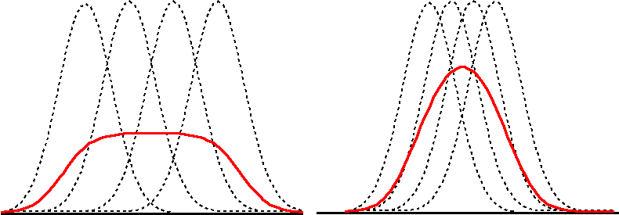
Jackknife Approach
Condition A
Condition B
Sub1
Sub2
Sub3
Sub4
Sub2
Sub3
Sub1
Sub4
Stim
Mean of single-subject values
Stim
Mean of single-subject values
Notes:
© S. J. Luck. All Rights Reserved. May be used for nonprofit educational purposes if this copyright notice is included. Permission must be obtained from the copyright holder(s) for any other use.

Slide 21
Jackknife Approach
Condition A
Condition B
Sub1
Sub2
Sub3
Sub4
Sub2
Sub3
Sub1
Sub4
Value from grand average
Value from grand average
Stim
Mean of single-subject values
Stim
Mean of single-subject values
A difference in timing variability is misconstrued as a difference in mean onset time
Notes:
© S. J. Luck. All Rights Reserved. May be used for nonprofit educational purposes if this copyright notice is included. Permission must be obtained from the copyright holder(s) for any other use.

Slide 22

Problem of Multiple Comparisons
If we do 10 independent statistical tests, and the null hypothesis is true for all 10, there is a 41% chance that at least one will be significant (false positive)
Example: Assessing side effects of Starbukine
Notes:
Photo: https://commons.wikimedia.org/wiki/File:Guangzhou_Starbucks_01b.jpg (public domain)
All other material: © S. J. Luck. All Rights Reserved. May be used for nonprofit educational purposes if this copyright notice is included. Permission must be obtained from the copyright holder(s) for any other use.

Slide 23
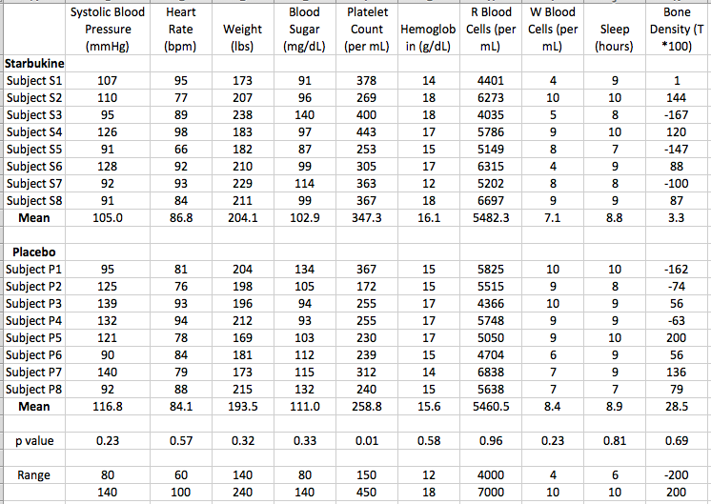
Notes:
© S. J. Luck. All Rights Reserved. May be used for nonprofit educational purposes if this copyright notice is included. Permission must be obtained from the copyright holder(s) for any other use.

Slide 24
Bonferroni Correction- 5% chance of even a single bogus p value in a family of tests (if the null is true for all tests)
If you find 100 significant values, there is only a 5% chance that even a single one of them will be bogus
False Discovery Rate (FDR) Correction- 5% of the significant tests would be expected to be bogus (if the null is true for all tests)
If you find 100 significant values, you would expect that ~5 would be false positives
If the null hypothesis is true for all tests, FDR = Bonferroni
Notes:
© S. J. Luck. All Rights Reserved. May be used for nonprofit educational purposes if this copyright notice is included. Permission must be obtained from the copyright holder(s) for any other use.

Slide 25
Multiple Implicit Comparisons
In ERP research, we often have the “problem of multiple implicit comparisons”
By eye, we compare two conditions at multiple time points and at multiple electrode sites
Then we do our statistical analyses only for the time regions and electrode clusters where we see an effect
This can dramatically inflate the Type I error rate
Even if the null hypothesis is true, you will almost always be able to find a “significant” difference in some time periods at some electrode sites
Notes:
© S. J. Luck. All Rights Reserved. May be used for nonprofit educational purposes if this copyright notice is included. Permission must be obtained from the copyright holder(s) for any other use.

Slide 26
An Example
Goal: Simulate a null effect in an oddball experiment
Take 640 standards per subject from a real oddball experiment
Divide them randomly into 512 “Standards” and 128 “Targets”
Null hypothesis is true by definition
Any differences are a result of sampling error
Notes:
Adapted from Figure 10.1 in Luck, S.J. (2014). An Introduction to the Event-Related Potential Technique, Second Edition. Cambridge, MA: MIT Press. © MIT Press.
This material may be used for nonprofit research and education purposes only, and it may not be reprinted or distributed in any form including print and electronic forms.

Slide 27
Simulated Standards & Targets
We know with 100% certainty that these effects are bogus because the simulated standards and targets were selected at random from a single population of trials
Broadly distributed across the right hemisphere
Limited to C3/C4/P3/P4
Notes:
Adapted from Figure 10.1 in Luck, S.J. (2014). An Introduction to the Event-Related Potential Technique, Second Edition. Cambridge, MA: MIT Press. © MIT Press.
This material may be used for nonprofit research and education purposes only, and it may not be reprinted or distributed in any form including print and electronic forms.

Slide 28
Simulated Standards & Targets
“P1 effect”
Measure mean amplitude from 50-150 ms at all electrodes
Main effect of condition: p = .051
Condition x hemisphere interaction: p = .011
“P2 effect”
Measure mean amplitude from 150-250 ms at C3/C4/P3/P4
Main effect of condition: p = .026
These effects are completely bogus and are significant only because we used the observed results to select the time periods and electrodes sites for the analysis
Broadly distributed across the right hemisphere
Limited to C3/C4/P3/P4
Notes:
Adapted from Figure 10.1 in Luck, S.J. (2014). An Introduction to the Event-Related Potential Technique, Second Edition. Cambridge, MA: MIT Press. © MIT Press.
This material may be used for nonprofit research and education purposes only, and it may not be reprinted or distributed in any form including print and electronic forms.

Slide 29
Hints for Detecting Bogus Effects
Don’t believe effects that are implausibly early
Effects prior to 100 ms are almost certainly bogus unless they are stimulus effects or spatial attention effects
Don’t believe effects at unexpected electrode sites
P1 is not usually seen over front half of the head
Don’t believe effects that start near time zero and last a long time
Demand a replication before you believe
Apply these standards to your own data!
Broadly distributed across the right hemisphere
Limited to C3/C4/P3/P4
Notes:
Adapted from Figure 10.1 in Luck, S.J. (2014). An Introduction to the Event-Related Potential Technique, Second Edition. Cambridge, MA: MIT Press. © MIT Press.
This material may be used for nonprofit research and education purposes only, and it may not be reprinted or distributed in any form including print and electronic forms.

Slide 30
Choosing Time Windows
Alternative 1: A priori window
Alternative 2: Average across conditions/groups to find appropriate window
2a: Peak ± 100 ms (or 200, or 300, etc.)
2b: In factorial design, look at difference wave for one factor collapsed across the other factor (e.g., rare-minus-frequent collapsed across patient/control)
Alternative 3: “Functional localizer” condition to find temporal “ROI”
Example: Faces vs. Cars to find N170 window (and then use this window for a more subtle comparison, such as Males vs Females)
Alternative 4: Use large window with “signed area” and permutation test
Notes:
© S. J. Luck. All Rights Reserved. May be used for nonprofit educational purposes if this copyright notice is included. Permission must be obtained from the copyright holder(s) for any other use.

Slide 31
Signed Area
We can use a large a priori measurement window without suffering cancellation
Question: Is Rare–Frequent difference > 0?
Problem: Signed area is biased (always >= 0) — what value would we expect if Rare and Frequent are identical except for noise?
Solution: Use permutation approach to determine null distribution (negative area value expected if Rare = Frequent)
Notes:
© S. J. Luck. All Rights Reserved. May be used for nonprofit educational purposes if this copyright notice is included. Permission must be obtained from the copyright holder(s) for any other use.

Slide 32
The Permutation Approach
General logic: To determine the value expected by random chance, randomly shuffle the data to see what value is produced by chance
For published example, see
Sawaki, Geng, & Luck (2012, JNeurosci)
Notes:
© S. J. Luck. All Rights Reserved. May be used for nonprofit educational purposes if this copyright notice is included. Permission must be obtained from the copyright holder(s) for any other use.

Slide 33
Choosing Time Windows
Alternative 5: Measure mean amplitude from multiple sequential time periods and use time as a factor in the ANOVA
Notes:
© S. J. Luck. All Rights Reserved. May be used for nonprofit educational purposes if this copyright notice is included. Permission must be obtained from the copyright holder(s) for any other use.

Slide 34
Example: Consecutive Time windows for N2ac
Notes:
Adapted with permission from Figure 1 from Gamble, M. L., & Luck, S. J. (2011). N2ac: An ERP component associated with the focusing of attention within an auditory scene. Psychophysiology, 48. This material may be used for nonprofit research and education purposes only, and it may not be reprinted or distributed in any form including print and electronic forms.

Slide 35
Example: Consecutive Time windows for N2ac
Measure: Difference wave from 200-300, 300-400, 400-500, 500-600 ms at each electrode
Key Effects
Difference from zero: Significant
Time: Significant
Electrode: ns
Contra/Ipsi Test @ Each Time Interval
200-300: Significant
300-400: Significant
400-500: Significant
500-600: ns
Notes:
Adapted with permission from Figure 1 from Gamble, M. L., & Luck, S. J. (2011). N2ac: An ERP component associated with the focusing of attention within an auditory scene. Psychophysiology, 48. This material may be used for nonprofit research and education purposes only, and it may not be reprinted or distributed in any form including print and electronic forms.

Slide 36
Choosing Time Windows
Alternative 1: A priori window
Alternative 2: Average across conditions/groups to find appropriate window
2a: Peak ± 100 ms (or 200, or 300, etc.)
2b: In factorial design, look at difference wave for one factor collapsed across the other factor (e.g., rare-minus-frequent collapsed across patient/control)
Alternative 3: “Functional localizer” condition to find temporal “ROI”
Example: Faces vs. Cars to find N170 window (and then use this window for a more subtle comparison, such as Males vs Females)
Alternative 4: Use large window with “signed area”
Alternative 5: Use time as a factor in the ANOVA
Alternative 6: Mass univariate approach
Notes:
© S. J. Luck. All Rights Reserved. May be used for nonprofit educational purposes if this copyright notice is included. Permission must be obtained from the copyright holder(s) for any other use.

Slide 37
Choosing Electrode Sites
Alternative 1: A priori region of interest
May average across sites prior to measuring amplitude/latency
Alternative 2: All sites in an omnibus ANOVA
May collapse into a smaller number of clusters first
Usually involves looking for condition x electrode interaction (low power, especially with Greenhouse-Geisser correction)
Alternative 3: Use “functional localizer” condition
Example: Faces vs. Cars to find N170 ROI (and then use this ROI for a more subtle comparison, such as Males vs Females)
Alternative 4: t test at each electrode with Bonferonni correction for multiple comparisons (very low power)
Or false discovery rate correction (not quite as bad)
Alternative 5: Mass univariate approach
Notes:
© S. J. Luck. All Rights Reserved. May be used for nonprofit educational purposes if this copyright notice is included. Permission must be obtained from the copyright holder(s) for any other use.

Slide 38
The Mass Univariate Approach
Goal: Avoid biases introduced by selecting time windows or electrode sites
General approach: Test all time points and all electrode sites, with an intelligent correction for multiple comparisons
May have thousands of t values (# of time points x # of electrode sites)
Several different approaches to correction are possible
Potential problem: low power
Power can be increased if have a priori information that can reduce the number of time points or electrode sites
For example, analyze 200-800 ms at posterior electrode sites
Notes:
© S. J. Luck. All Rights Reserved. May be used for nonprofit educational purposes if this copyright notice is included. Permission must be obtained from the copyright holder(s) for any other use.

Slide 39
Example Experiment
12 subjects
300 time points (0-600 ms, 500 Hz)
10 electrode sites
3000 t tests
150 (5%) bogus effects expected without correction
Notes:
Adapted from Figure 13.1 in Luck, S.J. (2014). An Introduction to the Event-Related Potential Technique, Second Edition. Cambridge, MA: MIT Press. © MIT Press.
This material may be used for nonprofit research and education purposes only, and it may not be reprinted or distributed in any form including print and electronic forms.

Slide 40
Rare Minus Frequent t Values
Notes:
Adapted from Figure 13.2 in Luck, S.J. (2014). An Introduction to the Event-Related Potential Technique, Second Edition. Cambridge, MA: MIT Press. © MIT Press.
This material may be used for nonprofit research and education purposes only, and it may not be reprinted or distributed in any form including print and electronic forms.

Slide 41
Rare Minus Frequent t Values
Uncorrected
Notes:
Adapted from Figure 13.2 in Luck, S.J. (2014). An Introduction to the Event-Related Potential Technique, Second Edition. Cambridge, MA: MIT Press. © MIT Press.
This material may be used for nonprofit research and education purposes only, and it may not be reprinted or distributed in any form including print and electronic forms.

Slide 42
Rare Minus Frequent t Values
Uncorrected
Bonferroni
Nothing is significant after correction except the very end of the P3 wave at C3, C4, and P3
However, we can be very confident that every single one of the significant points is real
Only 5% chance that even one of the significant effects is bogus
Notes:
Adapted from Figure 13.2 in Luck, S.J. (2014). An Introduction to the Event-Related Potential Technique, Second Edition. Cambridge, MA: MIT Press. © MIT Press.
This material may be used for nonprofit research and education purposes only, and it may not be reprinted or distributed in any form including print and electronic forms.

Slide 43
Rare Minus Frequent t Values
Uncorrected
Bonferroni
False Discovery
Rate (B&Y) after downsampling to 125 Hz and limiting analysis period to 200-600 ms
Many more points are significant with FDR
We would expect that only 5% of the significant points are bogus
Notes:
Adapted from Figure 13.2 in Luck, S.J. (2014). An Introduction to the Event-Related Potential Technique, Second Edition. Cambridge, MA: MIT Press. © MIT Press.
This material may be used for nonprofit research and education purposes only, and it may not be reprinted or distributed in any form including print and electronic forms.

Slide 44
Looking for Clusters
Uncorrected
Find all clusters of points that are significant at p < .05 uncorrected
Cluster is 2 or more adjacent time points or electrode sites
“Cluster mass” is the sum of the t values in a cluster
How big must a cluster mass be to be considered significant?
Cluster #1
Cluster #2
Notes:
Adapted from Figure 13.5 in Luck, S.J. (2014). An Introduction to the Event-Related Potential Technique, Second Edition. Cambridge, MA: MIT Press. © MIT Press.
This material may be used for nonprofit research and education purposes only, and it may not be reprinted or distributed in any form including print and electronic forms.

Slide 45
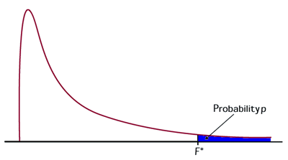
Permutation Example
Step 1- F test comparing Group A and Group B
Group A |  |  | Group B
A1 | 207 |  | B1 | 84
A2 | 305 |  | B2 | 102
A3 | 102 |  | B3 | 76
A4 | 56 |  | B4 | 13
A5 | 311 |  | B5 | 221
A6 | 280 |  | B6 | 103
A7 | 122 |  | B7 | 65
A8 | 302 |  | B8 | 190
A9 | 99 |  | B9 | 0
Mean | 198 |  |  | 95
SD | 104 |  |  | 73
F | 5.96
Question: Is this F larger than we would expect if null hypothesis is true?
Standard approach: Use parametric F distribution
But this requires many assumptions (normality, etc.)
Notes:
© S. J. Luck. All Rights Reserved. May be used for nonprofit educational purposes if this copyright notice is included. Permission must be obtained from the copyright holder(s) for any other use.

Slide 46
Permutation Example
Step 2- F test comparing permuted groups (Iteration 1)
Group A' |  |  | Group B'
A6 | 280 |  | B4 | 13
B3 | 76 |  | B5 | 221
A1 | 207 |  | B8 | 190
B7 | 65 |  | A9 | 99
B2 | 102 |  | A7 | 122
B6 | 103 |  | A3 | 102
A4 | 56 |  | A8 | 302
A2 | 305 |  | B9 | 0
A5 | 311 |  | B1 | 84
Mean | 167 |  |  | 126
SD | 108 |  |  | 97
F | 0.73
Alternative: Use our data to figure out the actual null distribution for this experiment
If the null hypothesis is true, group membership doesn’t matter
If we randomize (permute) group membership, this gives us the null distribution
If we calculate the F value for Groups A’ and B’, this F should be one possible value we would get if the null hypothesis is true
Notes:
© S. J. Luck. All Rights Reserved. May be used for nonprofit educational purposes if this copyright notice is included. Permission must be obtained from the copyright holder(s) for any other use.

Slide 47
Permutation Example
Step 3- Compute F values from 999 more random permutations
Group A' |  |  | Group B'
B5 | 118 |  | A4 | 56
B3 | 76 |  | B4 | 13
A2 | 305 |  | A7 | 122
A8 | 302 |  | B7 | 65
B8 | 190 |  | B1 | 84
A9 | 99 |  | A1 | 207
A6 | 280 |  | B2 | 102
B6 | 221 |  | B9 | 0
A3 | 102 |  | A5 | 311
Mean | 188 |  |  | 107
SD | 93 |  |  | 98
F | 3.27
With random permutations, the F value will usually be fairly small but will sometimes be large
The distribution of F values from these random permutations is what we would expect to see if the null hypothesis is true
Notes:
© S. J. Luck. All Rights Reserved. May be used for nonprofit educational purposes if this copyright notice is included. Permission must be obtained from the copyright holder(s) for any other use.

Slide 48
Permutation Example
Step 4- Compare “real” F value with permutation distribution
Bottom 950 F Values
(Bottom 95%)
Top 50 F Values (Top 5%)
Observed F = 5.96
The observed F is considered significant if it falls in the top 5% of the permutation distribution
Notes:
© S. J. Luck. All Rights Reserved. May be used for nonprofit educational purposes if this copyright notice is included. Permission must be obtained from the copyright holder(s) for any other use.

Slide 49
Looking for Clusters
Uncorrected
Find all clusters of points that are significant at p < .05 uncorrected
Cluster is 2 or more adjacent time points or electrode sites
“Cluster mass” is the sum of the t values in a cluster
How big must a cluster mass be to be considered significant?
Cluster #1
Cluster #2
Notes:
Adapted from Figure 13.5 in Luck, S.J. (2014). An Introduction to the Event-Related Potential Technique, Second Edition. Cambridge, MA: MIT Press. © MIT Press.
This material may be used for nonprofit research and education purposes only, and it may not be reprinted or distributed in any form including print and electronic forms.

Slide 50
Permutations and Cluster Mass
Step 1- Randomly shuffle the event codes so that the “targets” and “standards” are selected at random from a single population of trials
Notes:
Adapted from Figure 13.1 in Luck, S.J. (2014). An Introduction to the Event-Related Potential Technique, Second Edition. Cambridge, MA: MIT Press. © MIT Press.
This material may be used for nonprofit research and education purposes only, and it may not be reprinted or distributed in any form including print and electronic forms.

Slide 51
Permutations and Cluster Mass
Step 1- Randomly shuffle the event codes so that the “targets” and “standards” are selected at random from a single population of trials
Notes:
Adapted from Figure 13.1 in Luck, S.J. (2014). An Introduction to the Event-Related Potential Technique, Second Edition. Cambridge, MA: MIT Press. © MIT Press.
This material may be used for nonprofit research and education purposes only, and it may not be reprinted or distributed in any form including print and electronic forms.

Slide 52
Permutations and Cluster Mass
Step 2- Compute t values comparing difference wave to zero at each time point and then find the largest cluster mass
9-point cluster, mass = 22.53
Notes:
© S. J. Luck. All Rights Reserved. May be used for nonprofit educational purposes if this copyright notice is included. Permission must be obtained from the copyright holder(s) for any other use.

Slide 53
Permutations and Cluster Mass
Step 3- Re-shuffle and compute largest cluster mass 999 more times to get null distribution
Step 4- A cluster in the real data is considered significant if its mass exceeds the 95% point in the null distribution
Notes:
© S. J. Luck. All Rights Reserved. May be used for nonprofit educational purposes if this copyright notice is included. Permission must be obtained from the copyright holder(s) for any other use.

Slide 54
Which Clusters Were Significant?
Uncorrected
Only the yellow cluster had a mass that exceeded the 95% point in the null distribution
However, this approach did a pretty good job of identifying the P3 effect
Cluster #1
Cluster #2
Notes:
Adapted from Figure 13.5 in Luck, S.J. (2014). An Introduction to the Event-Related Potential Technique, Second Edition. Cambridge, MA: MIT Press. © MIT Press.
This material may be used for nonprofit research and education purposes only, and it may not be reprinted or distributed in any form including print and electronic forms.

Slide 55
Making it Faster
Instead of shuffling the event codes and repeating all processing steps, you can just flip the waveforms for a random subset of subjects
Notes:
Adapted from Figure 13.4 in Luck, S.J. (2014). An Introduction to the Event-Related Potential Technique, Second Edition. Cambridge, MA: MIT Press. © MIT Press.
This material may be used for nonprofit research and education purposes only, and it may not be reprinted or distributed in any form including print and electronic forms.

Slide 56
The More-Is-Less Principle
The more conditions, time points, and electrodes are in your data, the less true statistical power you will have.
If you have data from 2 conditions and 2 electrode sites, and you limit your analyses to a time window of 200-300 ms, you will have very few opportunities for noise to impact your data, and you will have very few implicit or explicit choices to make about how to analyze your data. This gives you more power, because correcting for multiple comparisons decreases your power.
If you have data from 42 conditions and 128 electrode sites, and you look at the entire time period from 50 to 1500 ms poststimulus, there are thousands of opportunities for noise to produce statistically significant effects. Anything you do post hoc to avoid this inflation of the Type I error rate will reduce your statistical power.
Notes:
© S. J. Luck. All Rights Reserved. May be used for nonprofit educational purposes if this copyright notice is included. Permission must be obtained from the copyright holder(s) for any other use.

